Slide 1



An Industrial Training Presentation
Presented By:
Sumadhur Vaidyula (201703100920006)
Arun Gauda (201603100910042)
B.Tech CE 8th Semester
CGPIT, UTU
External Guide:
Jaykishan Vansdawala
Director and CEO
I-Pangram LLP Services
Project Guide:
Ms. Shivani V. Vora
Assistant Professor (CE)
CGPIT, UTU

Slide 2
Contents
Company Profile
Project Introduction
Motivation
Project Objective
Timeline Chart
Training Work
Technologies/Platform
Modules of Project
Project Screenshots
Future Expansion
Conclusion
References

Slide 3





Company Profile
About:
With 40+ Employees and 500+ satisfied customers the company has raised itself as one of the industry standards.
Services:
UI/UX, Angular/React Front End Development
REST API/ NodeJS/Meteor JS Backend Development
Mobile App / React Native App Development
Internet Of Things / Serverless Application Development
AI/ML and Blockchain
Contact:
Email: sales@jacksolutions.co
Address: 302, Meridian Tower, Udhna Darwaja, Surat
Products:

Slide 4
Project Introduction
Project Title: Dolly – A Virtual Assistant
The idea is to make an user friendly robot (like Alexa) , which can be useful for human being not only for entertainment purpose but also may help him through his regular activities.
The project basically has two parts: A static version and Dynamic Version.
In the static version of the project, the STT and TTS are completely offline based on user defined model and it has limited features with access to limited users.
In the dynamic version, the STT is online which makes this version more interactive and provides accurate results.

Slide 5
Motivation
The main source of motivation has directly came from the smart household devices such as Alexa, Google home and many more.
Here, we have tried to mitigate the limitations of these smart devices as much as possible.
Also this project eyes to be a system which not only provides entertainment but also helps human beings in their regular activities.

Slide 6
Objective
The Main objective is to make a Voice assistant, which will be able to communicate with the user.
Apart from that, it should be performing predefined tasks according to the user’s command.
The objective of the static version is to make a system for personal and professional use in an industry where limited number of authorized users can access the system.
The objective of the Dynamic version is to make a system for general purpose as a household virtual assistant, which can be accessed by any user .

Slide 7
Timeline Chart
Internship Starts
Dynamic Version of Project
Dec 9
Static Version Ends
Object Detection using Retina-net
Begin Research on Jasper Framework
Internship End
Static Version
Feb 01
Add New Features
Dec 15
Jan 15
Mar 02
Mar 29
Nov 7
May 16
Apr 21
Dec 20
2019
Dec
Jan
Feb
Mar
Apr
May
2020
6 days
Today
17 days
Flite TTS
24 days
Jan 15 – Jan 31
16 days
25 days
Static Version of Project using PocketSphinx STT
Dynamic Version Of Project and Object Detection using Retina-net
Add Modules like Youtube, Dictionary, Check Weather and Search on Google
Dec 9 – Jan
Feb 25 – Mar
Mar 29 – Apr 20

Slide 8
Modules of Project
Static Version : STT using Pocketsphinx and TTS using Festival / Flite-TTS
Dynamic Version : STT using SpeechRecognition and TTS using Pyttsx3.
Perform Actions after Text processing.

Slide 9
Difference between Static and Dynamic Versions
Static Version:
Static Version can process limited commands, which are in its vocabulary and the user has to say the specific command as it is mentioned in the dictionary of the processing model.
Its main limitation is, it can only process those voices which have been used while training the model. Thus only limited users can access it.
Also, the user should make sure while giving command that the frequency and accent of his input speech is similar to the one he used while recording.

Slide 10
Difference between Static and Dynamic Versions
Dynamic Version :
Dynamic version has no limitation of vocabulary, as STT is online, it can process any word spoke by the user. Also SpeechRecognition can Process Speech of any language which makes this version more dynamic and accurate.
It eradicates the limitation of the static version, as it can process any voice and also it can process different accents too.
The user can speak with any frequency of his voice, as the STT system is so accurate it can detect words from low pitch voice as well.

Slide 11







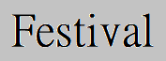

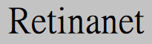
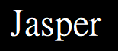


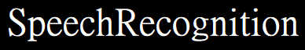

Technologies/Platforms Used

Slide 12
Training Work
Pocketsphinx STT :
Introduction:
Pocketspihnx is an offline speech to text python library
Pocketsphinx is part of CMUSphinx
The CMUSphinx project comes with several high-quality acoustic models. There are US English acoustic models for microphone and broadcast speech as well as a model for speech over a telephone
Besides models, CMUSphinx provides some approaches for adaptation which should suffice for most cases when more accuracy is required.

Slide 13
Training Work
Research on Pocketsphinx
When to train the Acoustic Model ?
If you want to create an acoustic model for a new language or dialect
If you have plenty of data to train on:
-1 hour of recording for command and control for a single speaker
-5 hours of recordings of 200 speakers for command and control for many speakers
-10 hours of recordings for single speaker dictation
-50 hours of recordings of 200 speakers for many speakers dictation
If you have knowledge on the phonetic structure of the language
If you have time to train the model and optimize the parameters (~1 month)

Slide 14
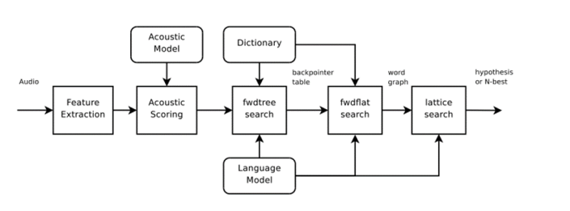
Training Work
Architecture Of Pocketsphinx
Image Source: https://www.researchgate.net/figure/Pocketsphinx-design-Architecture-Daines-2011_fig3_320711492

Slide 15
Training Work
Festival and Flite TTS :
Introduction:
Festival is an offline text to speech library.
Flite is a lite version of Festival.
Festival comes with various pre-installed audio samples which are freely available to use.
Besides these audio samples, festival also provide feature of adding a new audio and to use.

Slide 16
Training Work
Festival and Flite TTS :
Use:
Tested various audio sample until we got a clear one.
Festival TTS is mainly used for modifying the Static Version.
Further, Festival is again used to make an offline text to speech module for the dynamic version, hence machine can speak some basic instructions without any internet connectivity.

Slide 17
Training Work
SpeechRecognition:
Introduction:
A python library made by google for making Natural Language Processing easier.
Library for performing speech recognition, with support for several engines and APIs, online and offline.
Although, this library gives best output while online by using google speech recognition.

Slide 18
Training Work
SpeechRecognition:
Use:
In the dynamic version of the project, STT is done using this library.
SpeechRecognition can process commands mentioned in any language and in any accent .
Apart from that, its Neural network algorithm can also detect and learn new words spoken by the user.
As this library can work dynamically ,it gives various options to integrate it with various functionalities.

Slide 19
Training Work
Pyttsx3:
Introduction:
Pyttsx3 is an offline TTS library of python.
It has been used in the Dynamic Version of the project.
Pyttsx3 comes with different voices on different platforms, Sapi-5 in Windows and espeak in Ubuntu and MAC OS.
In this Project, Pyttsx3 alongside Sapi-5 voice is used.
Sapi-5 comes with both male and female voices .

Slide 20
Training Work
Keras-RetinaNet:
Introduction:
RetinaNet is one of the best one-stage object detection models that has proven to work well with dense and small scale objects.
Keras-Retinanet is a state of the art model, for image detection , which surpasses the quality of high performance models like, YOLO and Faster RCNN.

Slide 21
Training Work
Keras-RetinaNet:
Use:
With RetinaNet we have developed a model which can identify between two stages of milk i.e. steaming and boiling, in all light conditions.
We have trained by using 200 labelled images of both the scenarios having different background and lighting effects.

Slide 22
Training Work
Keras-RetinaNet:
Resnet50 Architecture:
The Keras-Retinanet in this project uses, Resnet50 as a backbone architecture for training and making predictions.
The Resnet50 Architecture consists of 4 Stages .

Slide 23
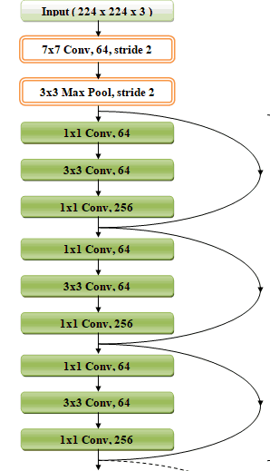
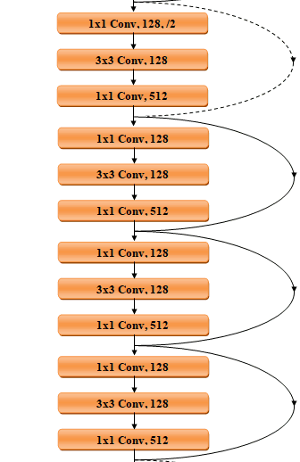
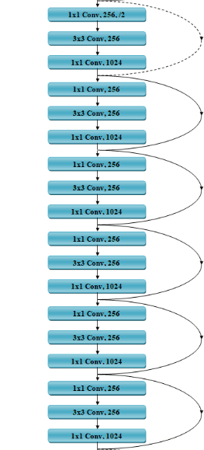
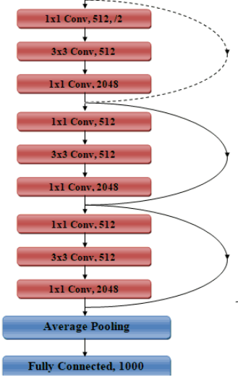
Training Work
Resnet50 Architecture:
Stage 1
Stage 2
Stage 3
Stage 4
Image Source: https://cv-tricks.com/keras/understand-implement resnets/#:~:text=Architecture%20of%20ResNet%2D50&text=The%20architecture%20of%20ResNet50%20has,shown%20in%20the%20diagram%20below.&text=Every%20ResNet%20architecture%20performs%20the,blocks%20containing%203%20layers%20each.

Slide 24
Training Work
Resnet50 Architecture:
Input Layer
The network can take the input image having height, width as multiples of 32 and 3 as channel width.
For the sake of explanation, we will consider the input size as 224 x 224 x 3.
Every ResNet50 architecture performs the initial convolution and max-pooling using 7×7 and 3×3 kernel sizes respectively.

Slide 25
Training Work
Resnet50 Architecture:
Stage-1
Stage 1 of the network starts and it has 3 Residual blocks containing 3 layers each.
The size of kernels used to perform the convolution operation in all 3 layers of the block of stage 1 are 64, 64 and 256 respectively.
The curved arrows refer to the identity connection.

Slide 26
Training Work
Resnet50 Architecture:
Stage-2
Stage 2 of the network has 4 Residual blocks containing 3 layers each.
The size of kernels used to perform the convolution operation in all 3 layers of the block of stage 2 are 128, 128 and 512 respectively.
The dashed connected arrow represents that the convolution operation in the Residual Block is performed with stride 2, hence, the size of input will be reduced to half in terms of height and width but the channel width will be doubled

Slide 27
Training Work
Resnet50 Architecture:
Stage-3
Stage 3 of the network has 6 Residual blocks containing 3 layers each.
The size of kernels used to perform the convolution operation in all 3 layers of the block of stage 3 are 256, 256 and 1024 respectively.
For each residual function F, 3 layers are stacked one over the other
The three layers are 1×1, 3×3, 1×1 convolutions.
The 1×1 convolution layers are responsible for reducing and then restoring the dimensions. The 3×3 layer is left as a bottleneck with smaller input/output dimensions.

Slide 28
Training Work
Resnet50 Architecture:
Stage-4
Stage 4 of the network has 3 Residual blocks containing 3 layers each.
The size of kernels used to perform the convolution operation in all 3 layers of the block of stage 4 are 512, 512 and 2048 respectively.
Here it is evident that, as we progress from one stage to another, the channel width is doubled and the size of the input is reduced to half.

Slide 29
Training Work
Resnet50 Architecture:
Final Layer
Average Pooling Layer:
An average pooling layer performs down-sampling by dividing the input into rectangular pooling regions and computing the average values of each region.
Fully Connected Layer:
Fully Connected Layer is simply, feed forward neural networks with 1000 neurons in this architecture.
The input to the fully connected layer is the output from the Average Pooling Layer or Convolutional Layer, which is flattened and then fed into the fully connected layer

Slide 30
Training Work
Path Navigation Algorithm:
Reinforcement Learning
The process of Reinforcement Learning involves these simple steps:
Observation of the environment
Deciding how to act using some strategy
Acting accordingly
Receiving a reward or penalty
Learning from the experiences and refining the strategy
Iterate until an optimal strategy is found

Slide 31
Training Work
Path Navigation Algorithm:
Q-Learning
Q-learning is a model-free reinforcement learning algorithm and is a values-based learning algorithm.
Value based algorithms updates the value function based on an equation (Bellman equation).
Q-learning is an off-policy learner.

Slide 32
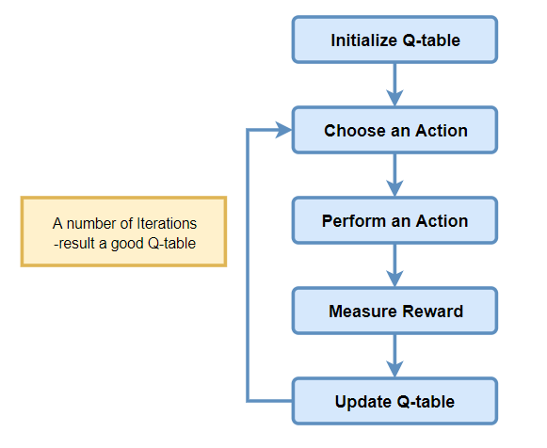
Training Work
Path Navigation Algorithm:
Q-learning Algorithm Process

Slide 33
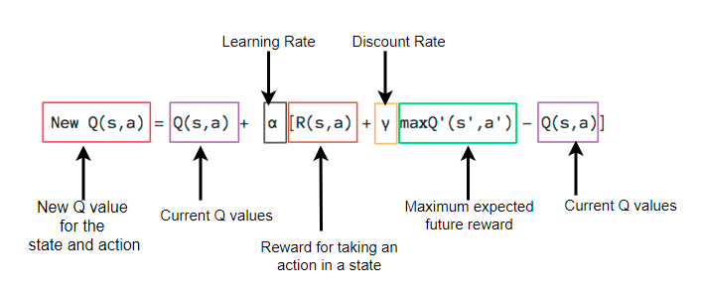
Training Work
Path Navigation Algorithm:
Bellman Equation Explanation for the episodes

Slide 34
Training Work
Jasper:
Japser is an open source platform for developing “Always On”, voice-controlled applications
Advantages of Jasper:
Controls Anything
Always Listening
Open Source

Slide 35
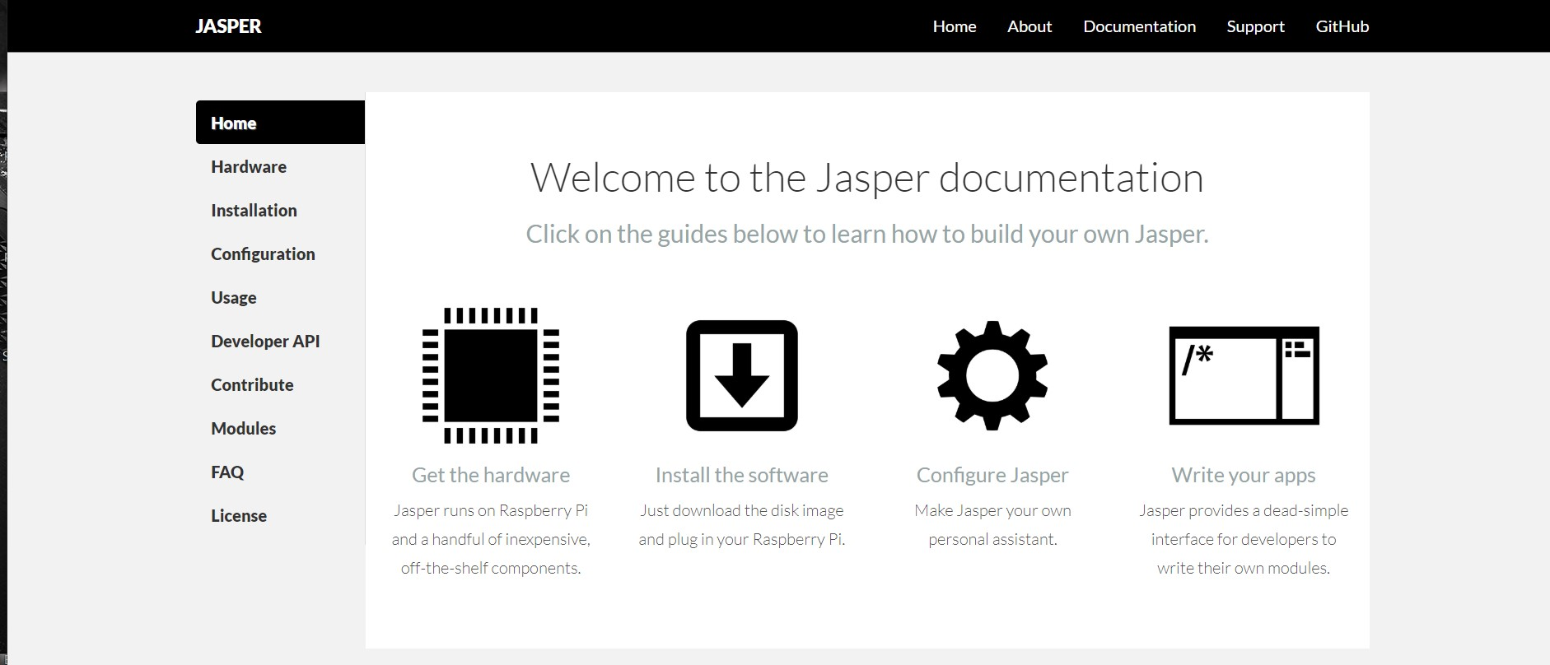
Training Work
Jasper:

Slide 36
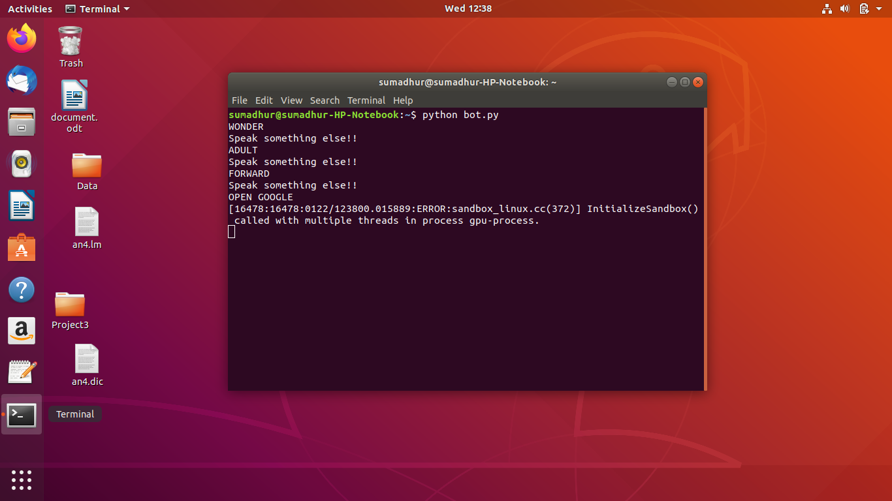
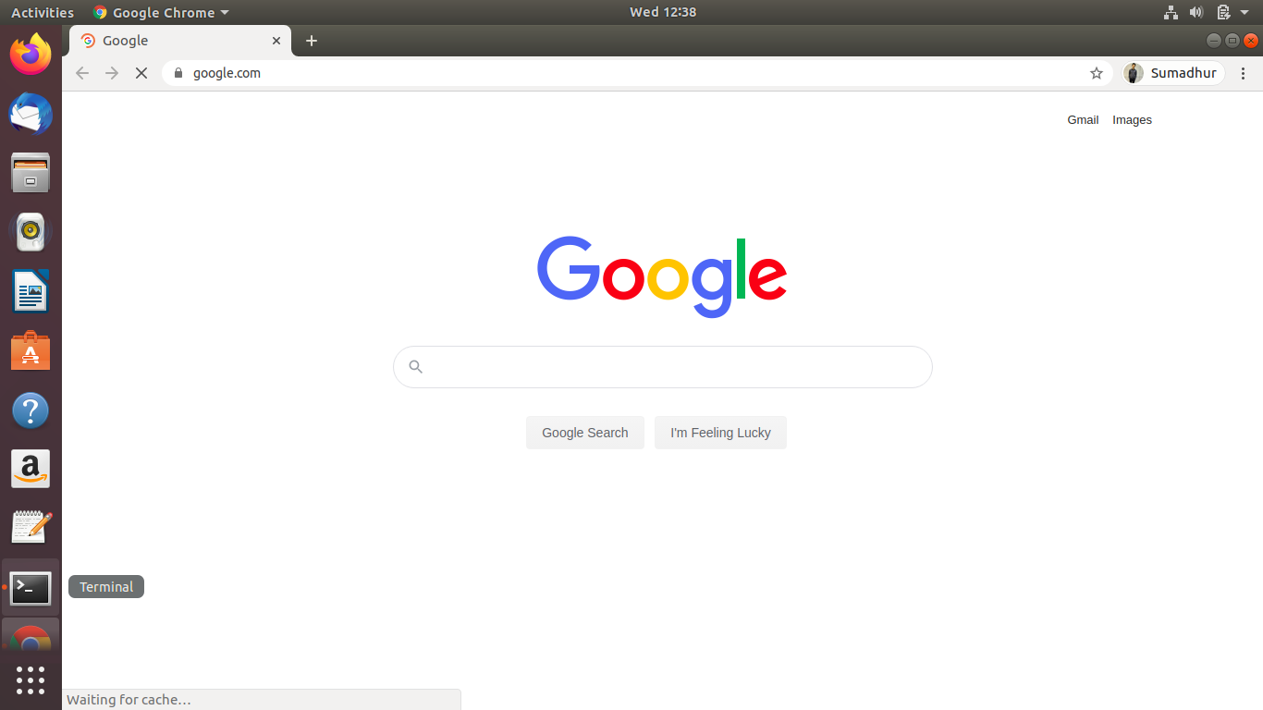
Project Implementation: Static Version
Performing actions corresponding to the speech detected.
Open Google:

Slide 37
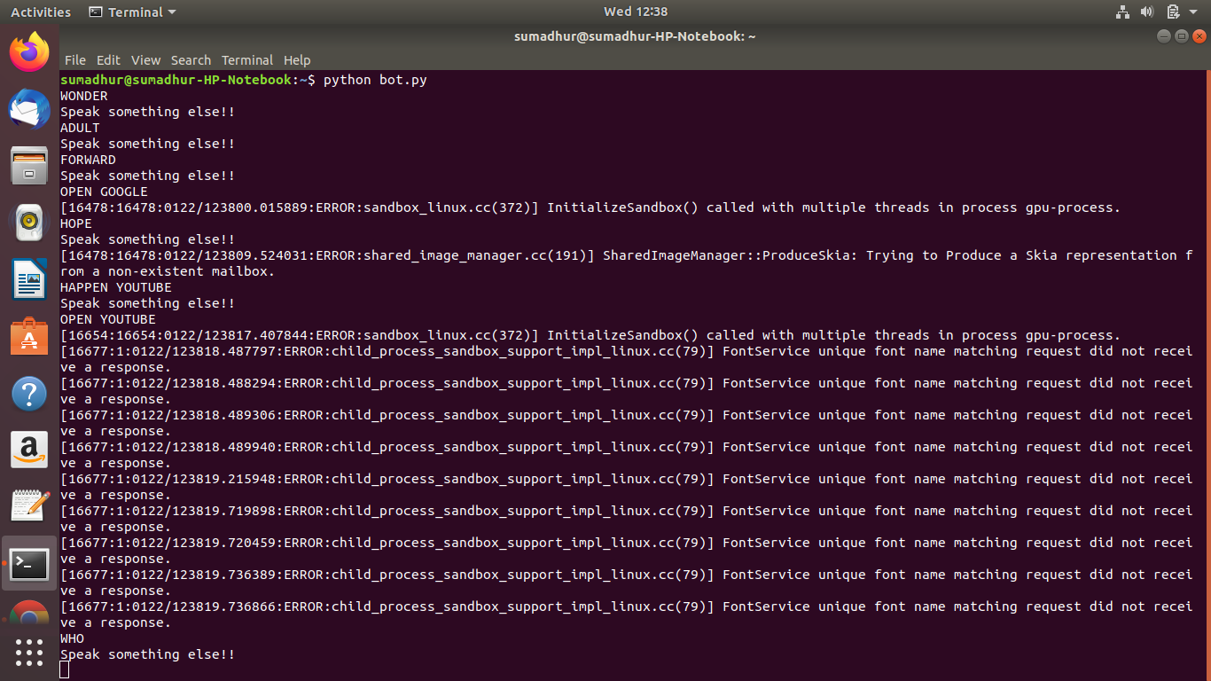
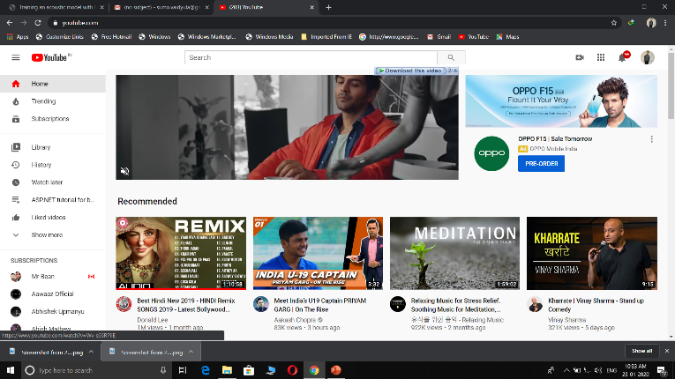
Project Implementation: Static Version
Performing actions corresponding to the speech detected.
Open YouTube:

Slide 38
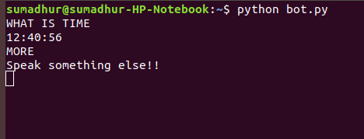
Project Implementation: Static Version
Performing actions corresponding to the speech detected.
Show Time:

Slide 39
Project Implementation: Dynamic Version

Slide 40
Project Implementation: Dynamic Version
Performing actions corresponding to the speech detected.
Open Google Tab in default browser.

Slide 41
Project Implementation: Dynamic Version
Performing actions corresponding to the speech detected.
Open Youtube tab in default browser:

Slide 42
Project Implementation: Dynamic Version
Performing actions corresponding to the speech detected.
Searching in Wikipedia :

Slide 43
Project Implementation: Dynamic Version
Performing actions corresponding to the speech detected.
Play Youtube video in python-vlc player:

Slide 44
Project Implementation: Dynamic Version
Performing actions corresponding to the speech detected.
Check weather of mentioned city:

Slide 45
Project Implementation: Dynamic Version
Performing actions corresponding to the speech detected.
Google search for nearest ATM:

Slide 46
Project Implementation: Dynamic Version
Performing actions corresponding to the speech detected.
Google search for nearest Restaurant:

Slide 47
Project Implementation: Dynamic Version
Checking Boiling Milk by Object Detection using Keras-Retinanet:
Model detects the stage of milk between Steaming and Boiling.
Steaming
Boiling

Slide 48
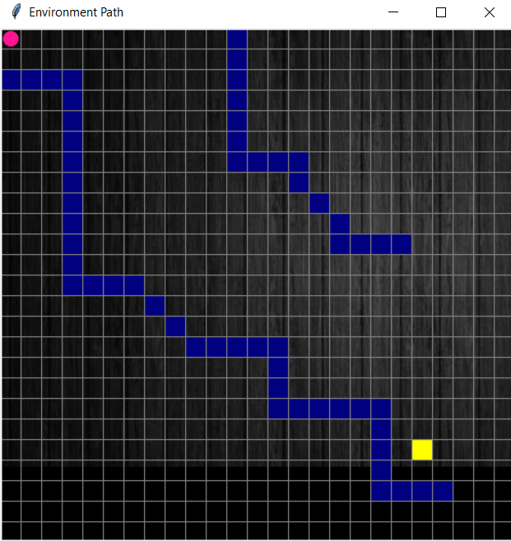
Project Implementation: Dynamic Version
Path Navigation Simulation in Python Tkinter:
Steaming
Boiling

Slide 49
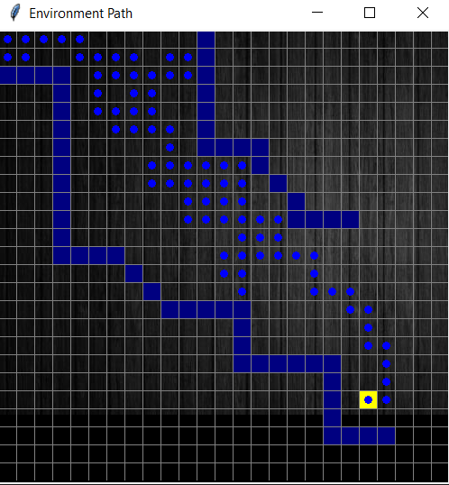
Project Implementation: Dynamic Version
Path Navigation Simulation in Python Tkinter:

Slide 50
Future Expansion
01
Integrating the software with a hardware (Raspberry PI)
02
Image Detection can be used for any specific task according to the requirement.
03
More searching functionalities can be added for better use.
04
Smart suggestions can be generated by observing user’s activity history.
05
Design the body of the bot, for selling purpose.

Slide 51
Conclusion:
Thus to conclude, this project is accurately built as a virtual assistant, which requires no other input from the user other than speech, It recognizes the speech and then converts it into text for further text processing and at the final stage performs the ordered task accordingly.
Also the objective of making this project not only for entertainment purpose, but also helps user in daily activities is also achieved.

Slide 52
REFERENCES
Paper references:
[1] David Huggins-Daines, Mohit Kumar, Arthur Chan, Alan W Black, Mosur Ravishankar, and Alex I.
Rudnicky , " POCKETSPHINX: A FREE, REAL-TIME CONTINUOUS SPEECH RECOGNITION
SYSTEM FOR HAND-HELD DEVICES" Carnegie Mellon University, Language Technologies
Institute,I185 to 188, June 2006.
[2] Toan M Hoang, Phong Ha Nguyen, Noi Quang Truong, and Young Won Lee, “ DEEP RETINANET-BASED
DETECTION AND CLASSIFICATION OF ROAD MARKINGS BY VISIBLE LIGHT CAMERA
SENSORS”, January 2019.

Slide 53
REFERENCES
Web references:
[3] [Online] https://cmusphinx.github.io/wiki/tutorialam/ [Date Accessed: 12 DEC 2019].
[4] [Online] https://sourceforge.net/projects/cmusphinx/ [Date Accsessed: 20 DEC 2019].
[5] [Online] https://github.com/cmusphinx/sphinxbase/blob/master/
[Date Accessed: 1 JAN 2020]
[6] [Online] https://cmusphinx.github.io/wiki/tutorialam/#setting-up-the-training-scripts
[Date Accessed: 15 JAN 2020]
[7] [Online] https://pyttsx3.readthedocs.io/en/latest/ [Date Accessed: 20 JAN 2020]
[8] [Online] https://towardsdatascience.com/review-retinanet-focal-loss-object-detection-38fba6afabe4 [Date
Accessed: 12 FEB 2020]
[9] [Online] http://www.festvox.org/flite/ [Date Accesed: 15 FEB 2020]
[10] [Online] https://docs.python.org/3/library/ [Date Accessed: 25 FEB 2020]
[11] [Online] https://towardsdatascience.com/retinanet-how-focal-loss-fixes-single-shotdetectioncb320e3bb0de
[Date Accessed: 20 FEB 2020]
[12][Online] https://jasperproject.github.io/documentation/ [Date Accessed: 15 Mar 2020]

Slide 54
Thank You

